Slide 2
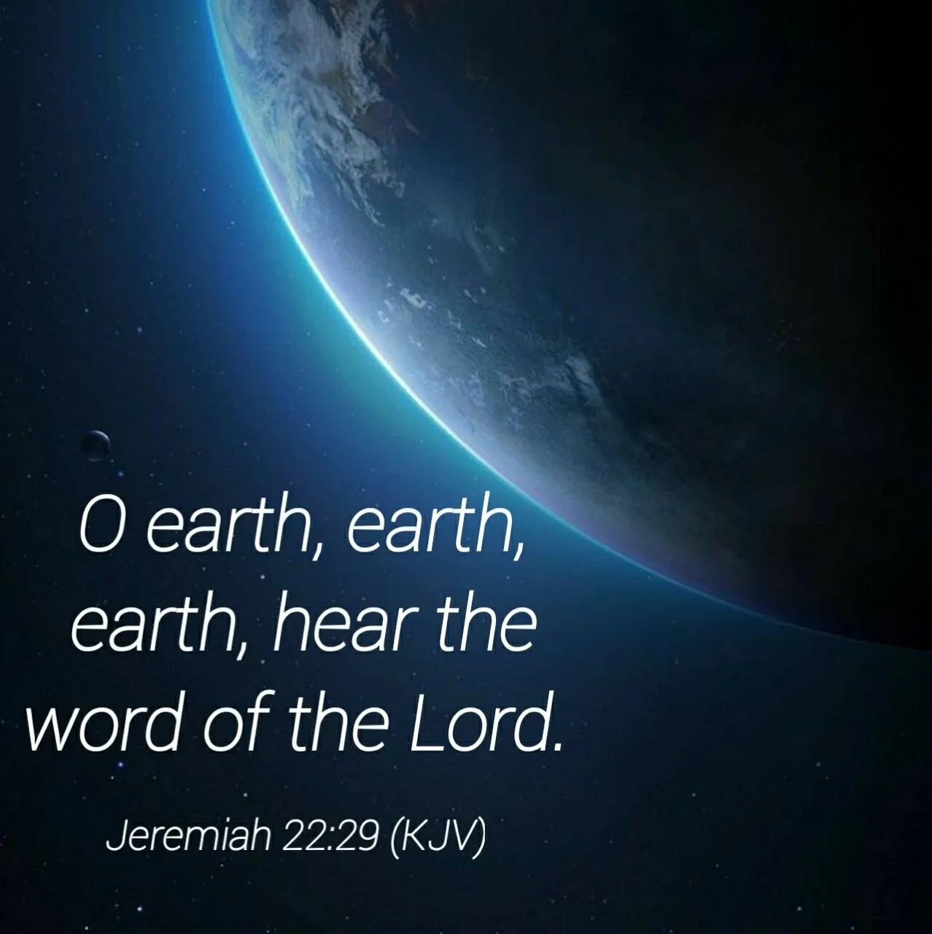
Hearing that is attentive, understood and obeyed

Slide 3
What is it that we are to “hear?”
THE WORD OF THE LORD!
Jeremiah 23:16,17 “everyone who walks according to the dictates of his own heart, they say, ‘No evil shall come upon you.”
Jeremiah 23:21.25-28 “I have not spoken to them, yet they prophesied.”

Slide 4
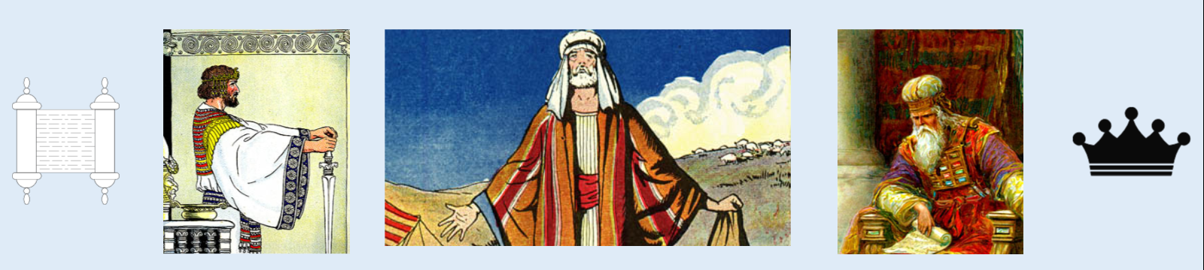
Problem did not cease with Jeremiah
Continued Down Through The Ages
Matthew 7:15 “beware of false prophets”

Slide 5
Christ rebuked those who would not heed the word of god
Mark 7:5-13 “you reject the commandment of God, that you may keep your tradition”
THE APOSTLES HAD THE PROBLEM
Colossians 2:8 “philosophy and empty deceit”
Titus 1:13,14 “not giving heed to Jewish fables and commandments of men”
2 Timothy 2:17,18 “who have strayed concerning the truth, saying that the resurrection is already past; and they overthrow the faith of some.”

Slide 6
Test and try the teachers
1 John 4:1 “do not believe every spirit, but test the spirits, whether they are of God; because many false prophets have gone out into the world.”
Revelation 2:2 “you have tested those who say they are apostles and are not”
NEED TO HAVE THE SPIRIT OF THE BEREANS-
Acts 17:11 “more fair-minded than those in Thessalonica”

Slide 7
Why the great folly of not yielding to the word of the lord?
God Cannot Lie – Hebrews 6:18
    Man CAN and DOES!
God Can Save – 1 Timothy 4:10
    Man CANNOT!
  God Can Destroy in Hell – Matthew 10:28
    Man CANNOT!

Slide 8
Essential to heed to the word of the lord
What are some hinderances to Hearing the Word? Romans 10:16-18
What are some Reasons behind this fact?
    Ignorance – Romans 10:1-3; Acts 3:14-17
    Not God’s fault – Romans 3:1,2
    Law to bring them to Christ – Romans 10:4; Galatians 3:24

Slide 9
Essential to heed to the word of the lord
Prophets bore witness – Acts 10:43; 26:22,23
They STILL ignorantly rejected Christ – Acts 13:27-30
MAN’S IGNORANCE TODAY NOT GOD’S FAULT
Word of God preached to all the world – Romans 15:19-21; Colossians 1:23
Everything for man’s salvation recorded- 2 Timothy 3:16,17; James 1:25; Jude 3

Slide 10
Willful ignorance
1 Corinthians 14:37,38
2 Peter 3:4-6
TO PROVE OR PROTECT A THEORY
2 Thessalonians 2:10-12
BECAUSE OF PREJUDICE
    Naaman – 2 Kings 5:9-11
    The Jews – 7:54-58; 22:17-23

Slide 11
Think there is sufficient time to change
Proverbs 27:1 “you do not know what a day may bring forth.”
James 4:13,14 “what is your life? It is even a vapor that appears for a little time and then vanishes away.”
WOULD YOU HEED GOD’S WORD IF DEATH WAS ONE HOUR AWAY?
HOW DO YOU KNOW THAT THIS IS NOT THE CASE?

Slide 12
RESPONSIBLE BEINGS WHO HAVE SINNED ARE UNDER A DEATH SENTENCE
UNLESS THEY HEAR AND OBEY GOD’S WORD!
Romans 8:1-4
HEAR CHRIST’S INVITATION FOR MAN TO BE SAVED- Matthew 11:28-30
HEAR GOD’S PLAN OF SALVATION- Mark 16:16; Acts 2:38; Romans 6:3-5
HEAR GOD’S APPROVED MANNER OF LIFE- 1 Timothy 4:12,16; Titus 2:11,12

Slide 13
RESPONSIBLE BEINGS WHO HAVE SINNED ARE UNDER A DEATH SENTENCE
HEAR THE CALL TO DUTY- Matthew 9:37
John 4:35
1 Corinthians 15:58
Philippians 2:12
PROMISES TO THE FAITHFUL & WARNINGS TO THE DISOBEDIENT – Romans 2:6-10
Revelation 2:10

Slide 14
Have I heeded the word of god?
Jeremiah 22:29

